Slide 1
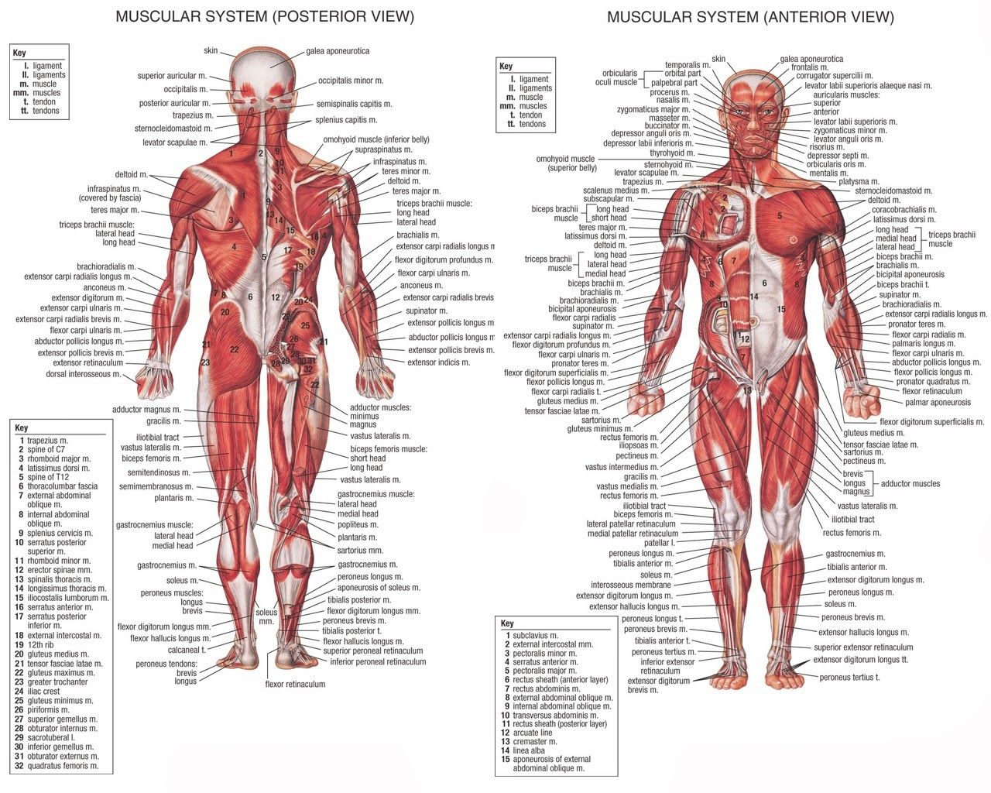

Slide 2
Daily Review
Vocabulary
Characteristic: Feature or quality Elastic: able to return to its normal shape after being stretched or compressed
Characteristics of Bones
Bones need to have three characteristics: strong, light and elastic
Think, pair, share: Why do bones need to be strong and elastic?
Think, pair, share: Why do bones need to be light?

Slide 3
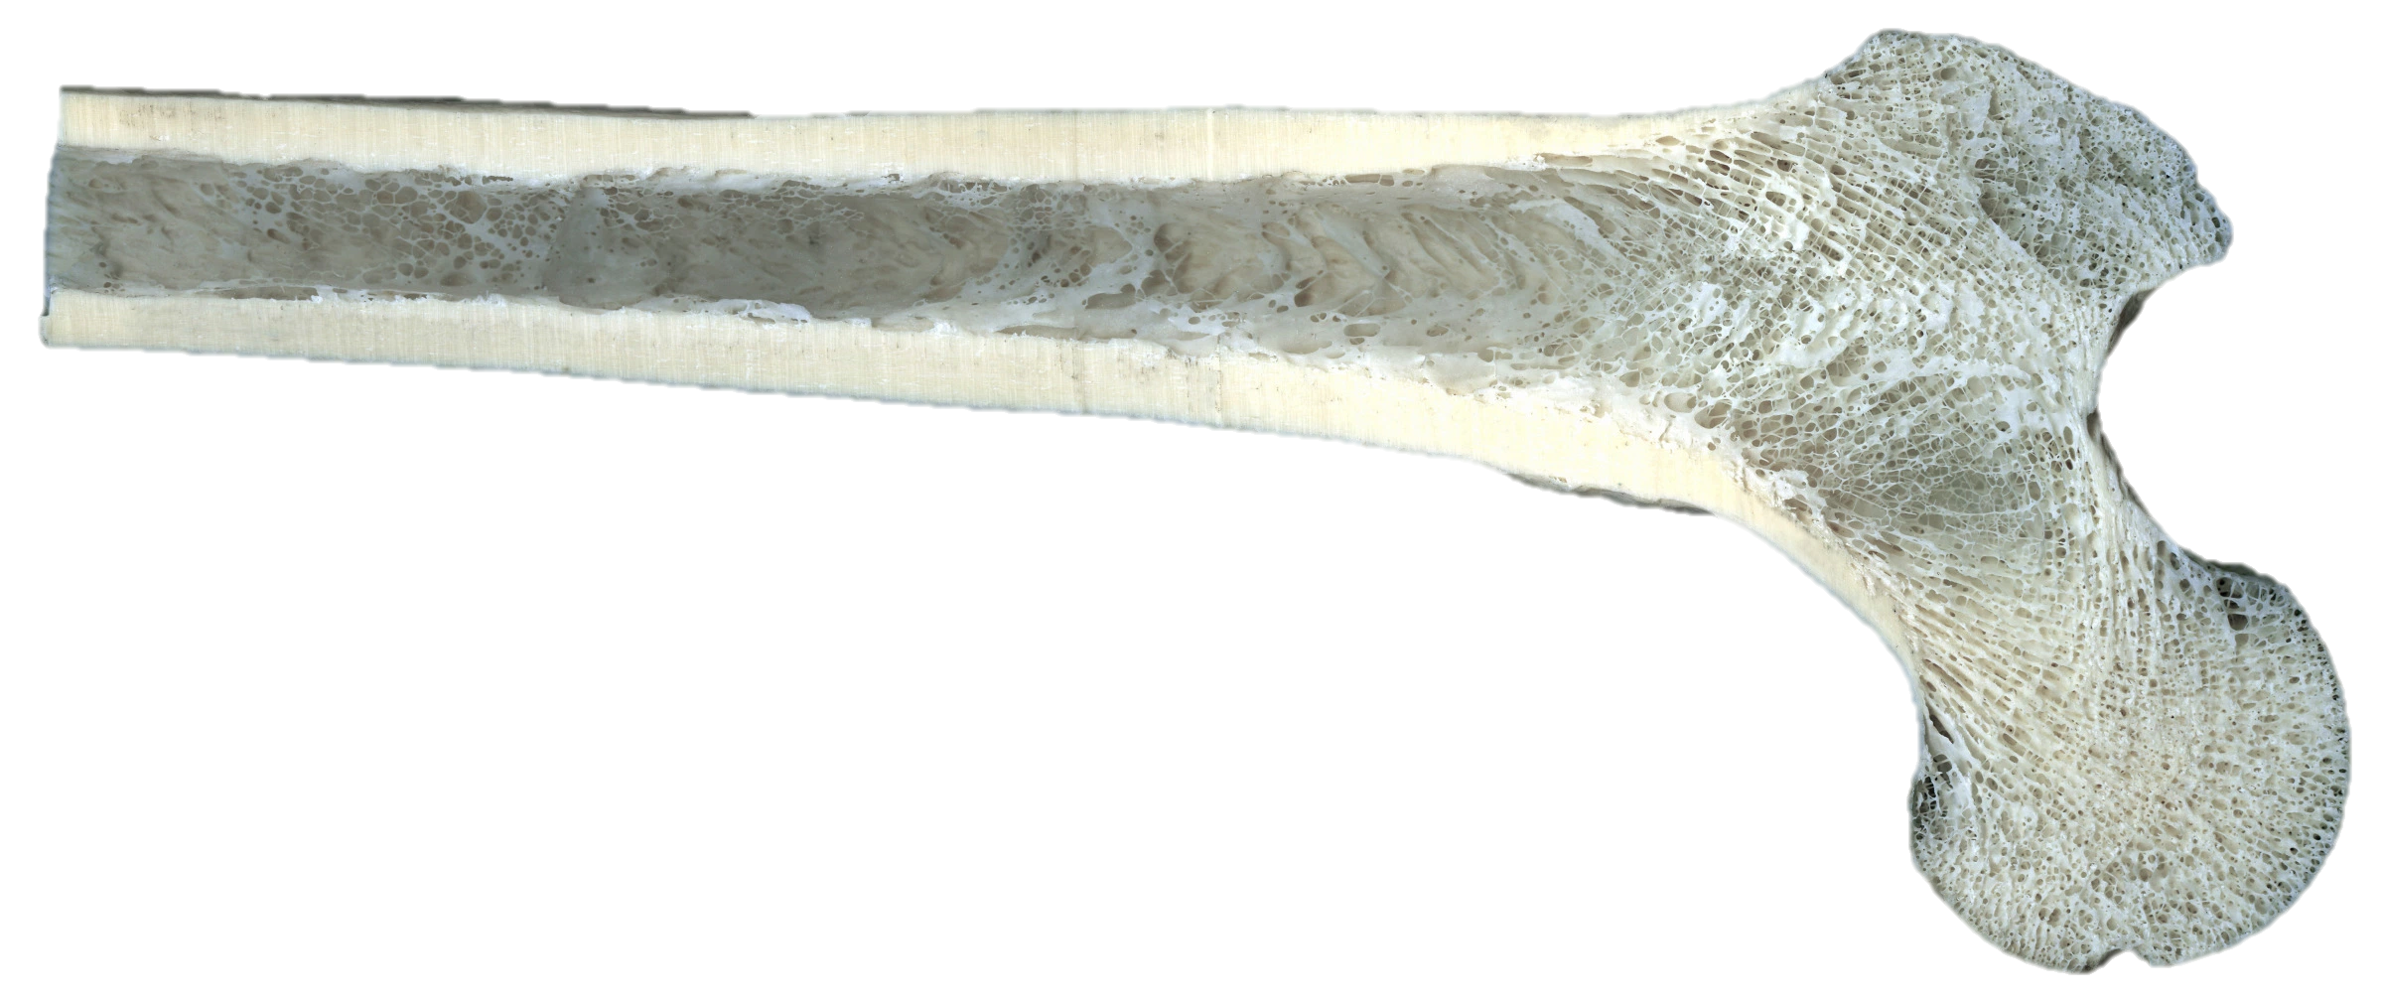
Daily Review
Vocabulary
Porous: has many holes
Structure of Bones
There are two types of bone tissue:
Compact bone is dense and heavy, for strength.
Spongy bone is porous, which makes it light.
Think, pair, share: How is spongy bone different to compact bone in terms of its structure?
Think, pair, share: How is spongy bone different to compact bone in terms of its function?

Slide 4
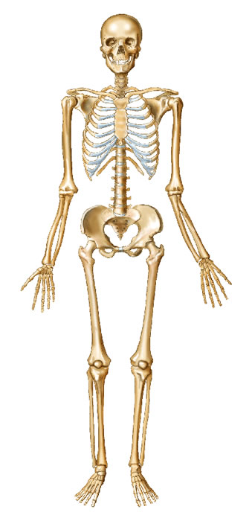
Daily Review
A
B
Major Bones in the Human Body
On your whiteboard, match the following bones to the corresponding letter on the diagram.
Pelvis, Femur, Clavicle, Skull, Vertebrae, Ribs, Patella
F
C
G
D
H
E
I
J
K
L

Slide 5
Musculoskeletal System: Muscles and Joints

Slide 6
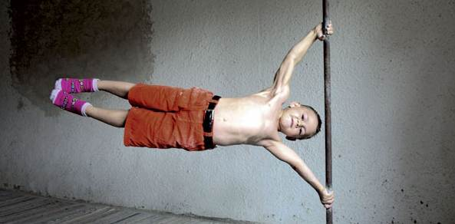
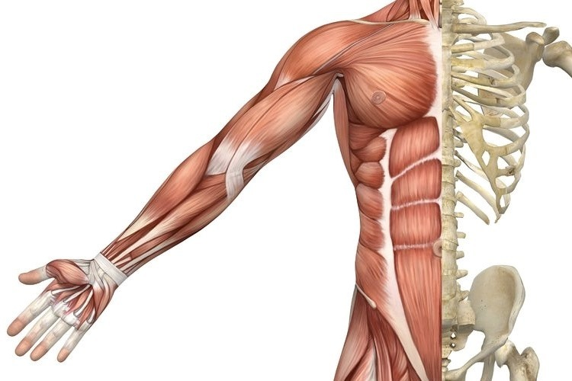
Learning Objectives
CFU
What are we going to learn?
Describe the function of antagonistic muscles
Identify the major muscles of the human body
Identify types of joints in the human body
Activate Prior Knowledge
There are over 650 muscles in the human body that move bones.
Think, Pair, Share: List the names of as many muscles as you can.

Slide 7
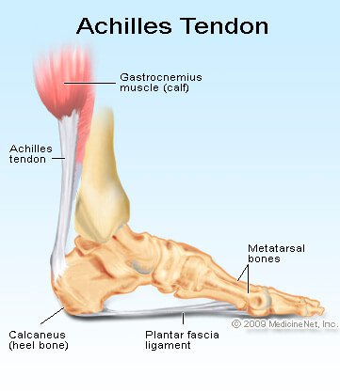
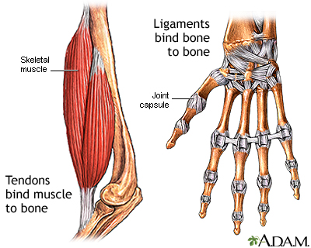
Concept Development
CFU 1
How are tendons and ligaments similar?
CFU 3
The Achilles tendon runs down the back of the heel. What is its function?
Tendons and Ligaments
Tendons and ligaments are tough bands of tissue.
Tendons connect muscles to bones.
Ligaments hold bones together.
CFU 2
How are tendons and ligaments different?

Slide 8
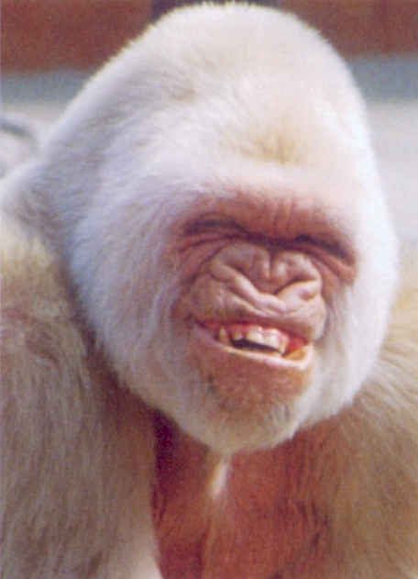
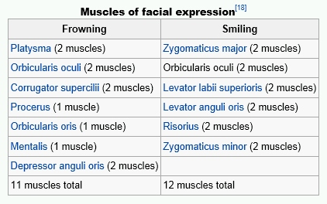
Concept Development
CFU 1
Do muscles push or pull?
Muscles
Muscles are able to contract.
They pull on the bone they are attached to, via a tendon, causing the bone to move.
Muscles can only pull, they cannot push.
Another muscle is needed to move the bone back to its original position.
CFU 2
When muscles contact, what happens to the bone they are attached to?
CFU 3
How is a bone moved back to its original position?
Did You Know?
It takes more muscles to frown than it does to smile!

Slide 9
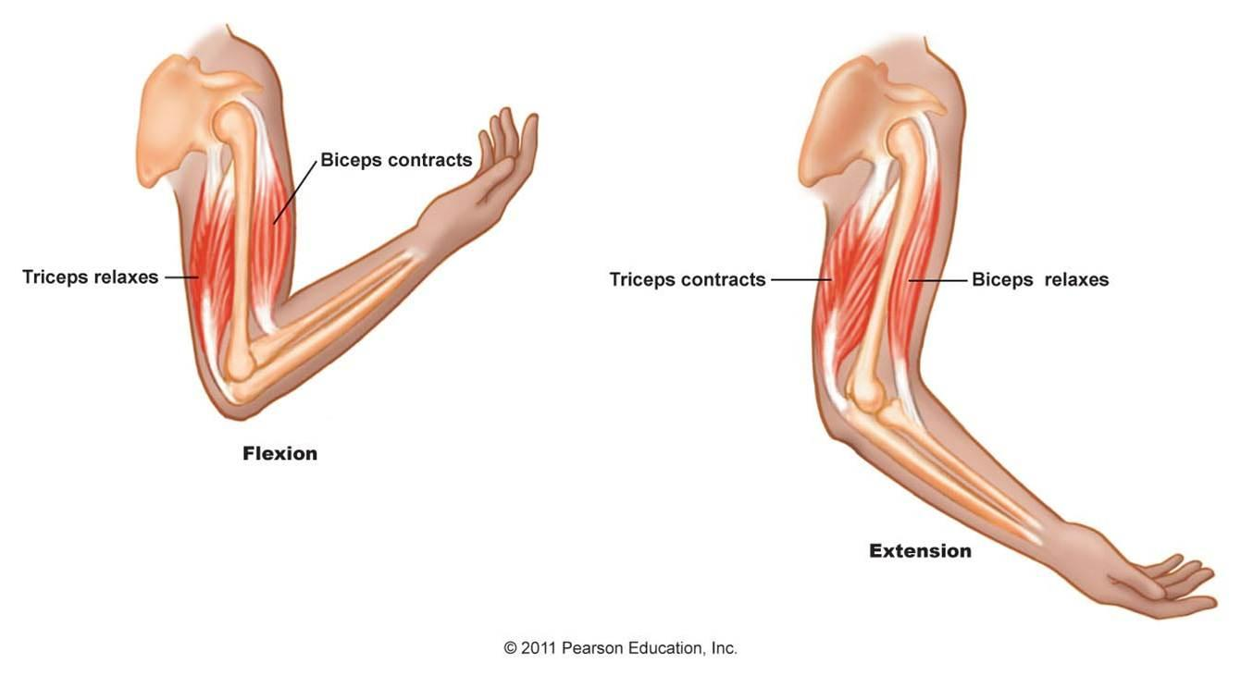
Concept Development
CFU 1
What is an antagonistic pair of muscles?
Antagonistic Muscles
Muscles are arranged in antagonistic pairs that work in opposition to each other.
The biceps and triceps are an antagonistic pair.
The biceps contracts, raising the arm.
The triceps contracts, lowering the arm.
CFU 2
Explain how the biceps and triceps work as an antagonistic muscle pair.
Vocabulary
Antagonistic: acting in opposition

Slide 10
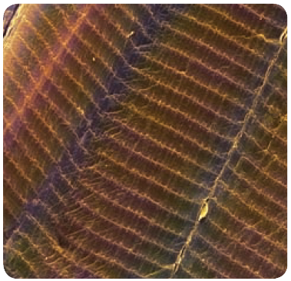
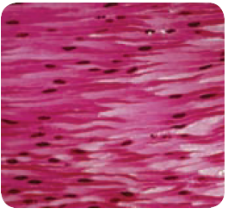
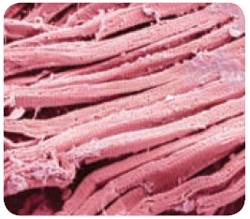
Concept Development
CFU 1
What is an example of a voluntary muscle?
Types of Muscles
Skeletal muscles are voluntary, and move the bones of the skeleton.
Smooth muscles are involuntary, and help our internal organs carry out functions such as breathing and digestion.
Cardiac muscles (heart muscles) allow the heart to beat continuously.
CFU 2
What is an example of a smooth muscle?
CFU 3
Think, Pair, Share: Is cardiac muscle voluntary or involuntary? Explain your choice.

Slide 11
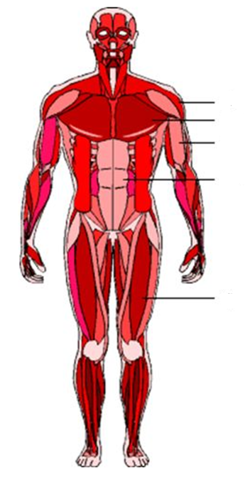
Concept Development
Major Muscles in the Human Body
Deltoidss
Pectorals
CFU 1
Which muscles move the arm?
Biceps
Abdominals
CFU 2
Which muscles cover the abdomen?
CFU 3
Which muscle could also be called the thigh muscle?
Quadriceps

Slide 12
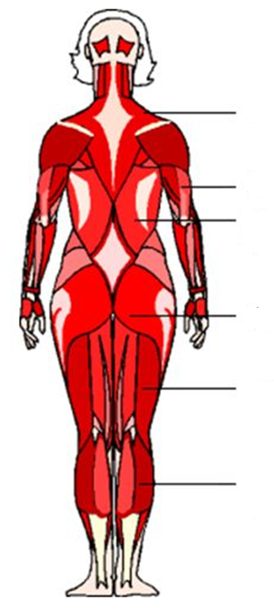
Concept Development
Major Muscles in the Human Body
Trapezius
CFU 1
Which muscle is shaped like a trapezium?
Triceps
Latissimus dorsi
CFU 2
Which muscles create the human ‘bottom’?
Gluteals
CFU 3
What is another name for our calf muscle?
Hamstrings
Gastrocnemius

Slide 13
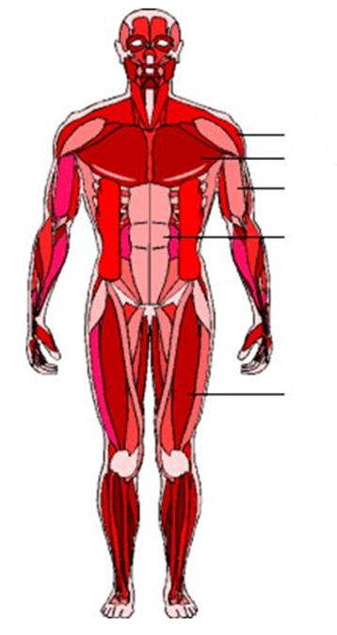
Skill Development/Guided Practice
Describing the function of muscles
1. Where on the body is the muscle located? 2. What part of the body does it move?
Biceps
Describe the function of the biceps.
The biceps is located on the front of the arm. It helps to move the forearm.

Slide 14
Skill Development/Guided Practice
Describing the function of muscles
1. Where on the body is the muscle located? 2. What part of the body does it move?
Describe the function of the quadriceps.
The biceps is located on the front of the upper leg/thigh. It helps to move the lower leg.
Quadriceps

Slide 15
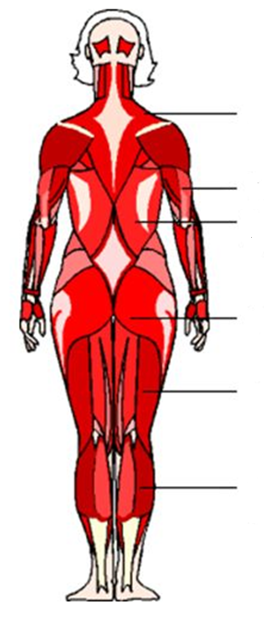
Skill Development/Guided Practice
Describing the function of muscles
1. Where on the body is the muscle located? 2. What part of the body does it move?
Triceps
Describe the function of the triceps.
The triceps is located on the back of the arm. It helps to move the forearm.

Slide 16
Skill Development/Guided Practice
Describing the function of muscles
1. Where on the body is the muscle located? 2. What part of the body does it move?
Gluteals
Describe the function of the gluteals.

Slide 17
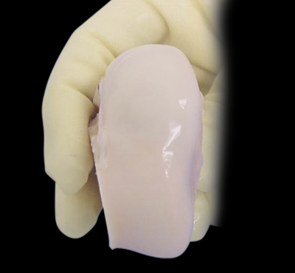
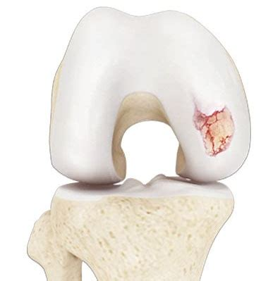
Concept Development
CFU 1
What is a joint?
CFU 2
What covers the ends of bones?
Joints
Joints are where two bones meet.
The ends of bones are covered in a smooth, slippery material called cartilage.
Cartilage reduces friction between the bones when they move.
CFU 3
What is the function of cartilage on the ends of bones?

Slide 18
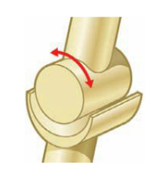
Concept Development
CFU 1
How does a hinge joint move?
Types of Joints - Hinge
Only moves backwards and forwards (like a door hinge)
Examples are the elbow, knee and finger joints
CFU 2
Are the joints in the toes hinge joints? Explain your choice.

Slide 19
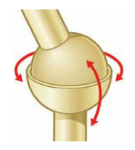
Concept Development
CFU 1
How does a hinge joint move?
Types of Joints – Ball and Socket
Allows movement in all directions
One bone has a ball shaped end that fits into the cup shape of the other bone
Examples are the hip and shoulder
CFU 2
Are the joints in the toes hinge joints? Explain your choice.

Slide 20
Skill Development/Guided Practice
CFU 1
Does the joint move in one direction or all directions?
Identifying joints
1. Does the joint only move backwards and forwards? = hinge 2. Does the joint move in all directions? = ball and socket
Describe the joint in the shoulder.
The shoulder is a ball and socket joint because it allow movement in all directions.

Slide 21
Skill Development/Guided Practice
CFU 1
Does the joint move in one direction or all directions?
Identifying joints
1. Does the joint only move backwards and forwards? = hinge 2. Does the joint move in all directions? = ball and socket
Describe the joint at the elbow.
The elbow is a hinge joint because it only moves backwards and forwards

Slide 22
Skill Development/Guided Practice
CFU 1
Does the joint move in one direction or all directions?
Identifying joints
1. Does the joint only move backwards and forwards? = hinge 2. Does the joint move in all directions? = ball and socket
Describe the joint at the knee.
The knee is a hinge joint because it only moves backwards and forwards

Slide 23
Skill Development/Guided Practice
CFU 1
Does the joint move in one direction or all directions?
Identifying joints
1. Does the joint only move backwards and forwards? = hinge 2. Does the joint move in all directions? = ball and socket
Describe the joint in the hip.
The hip is a ball and socket joint because it allow movement in all directions.

Slide 24
Relevance
Knowing how organs work together in a system and how the systems interact with each other will help you understand how the body works.
Understanding how muscles work together and the different types of joints in the body will help you understand how parts of the skeleton move.

Slide 25
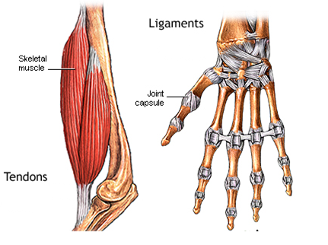
Skill Closure
How is a tendon different to a ligament?
Skill Closure
Use the images to explain an antagonistic muscle pair.
Skill Closure
Describe the joints in the fingers.
Identifying joints
1. Does the joint only move backwards and forwards? = hinge 2. Does the joint move in all directions? = ball and socket

Slide 26
Independent Practice
Collect and complete a hard copy of the Joints and Muscles worksheet.
Tendons and Ligaments
Tendons and ligaments are tough bands of tissue.
Tendons connect muscles to bones.
Ligaments hold bones together.
Antagonistic Muscles
Muscles are arranged in antagonistic pairs that work in opposition to each other.
The biceps and triceps are an antagonistic pair.
The biceps contracts raising the arm
The triceps contracts lowering the arm
Joints
Joints are where two bones meet.
The ends of bones are covered in a smooth, slippery material called cartilage.
Cartilage reduces friction between the bones when they move.
Types of Joints - Hinge
Only moves backwards and forwards (like a door hinge)
Examples are the elbow, knee and finger joints
Types of Joints – Ball and Socket
Allows movement in all directions
One bone has a ball shaped end that fits into the cup shape of the other bone
Examples are the hip and shoulder

